Slide 1
Results of Informational Survey of
ANCOR Board of Directors
April 2019

Slide 2
Board Member Demographics

Slide 3
Board Member Demographics
Breakdown by Age
Breakdown by Race/Ethnicity

Slide 4
Board Member Disability Status

Slide 5
Board Member Agency Information

Slide 6
Board Member Organization Corporate Status

Slide 7
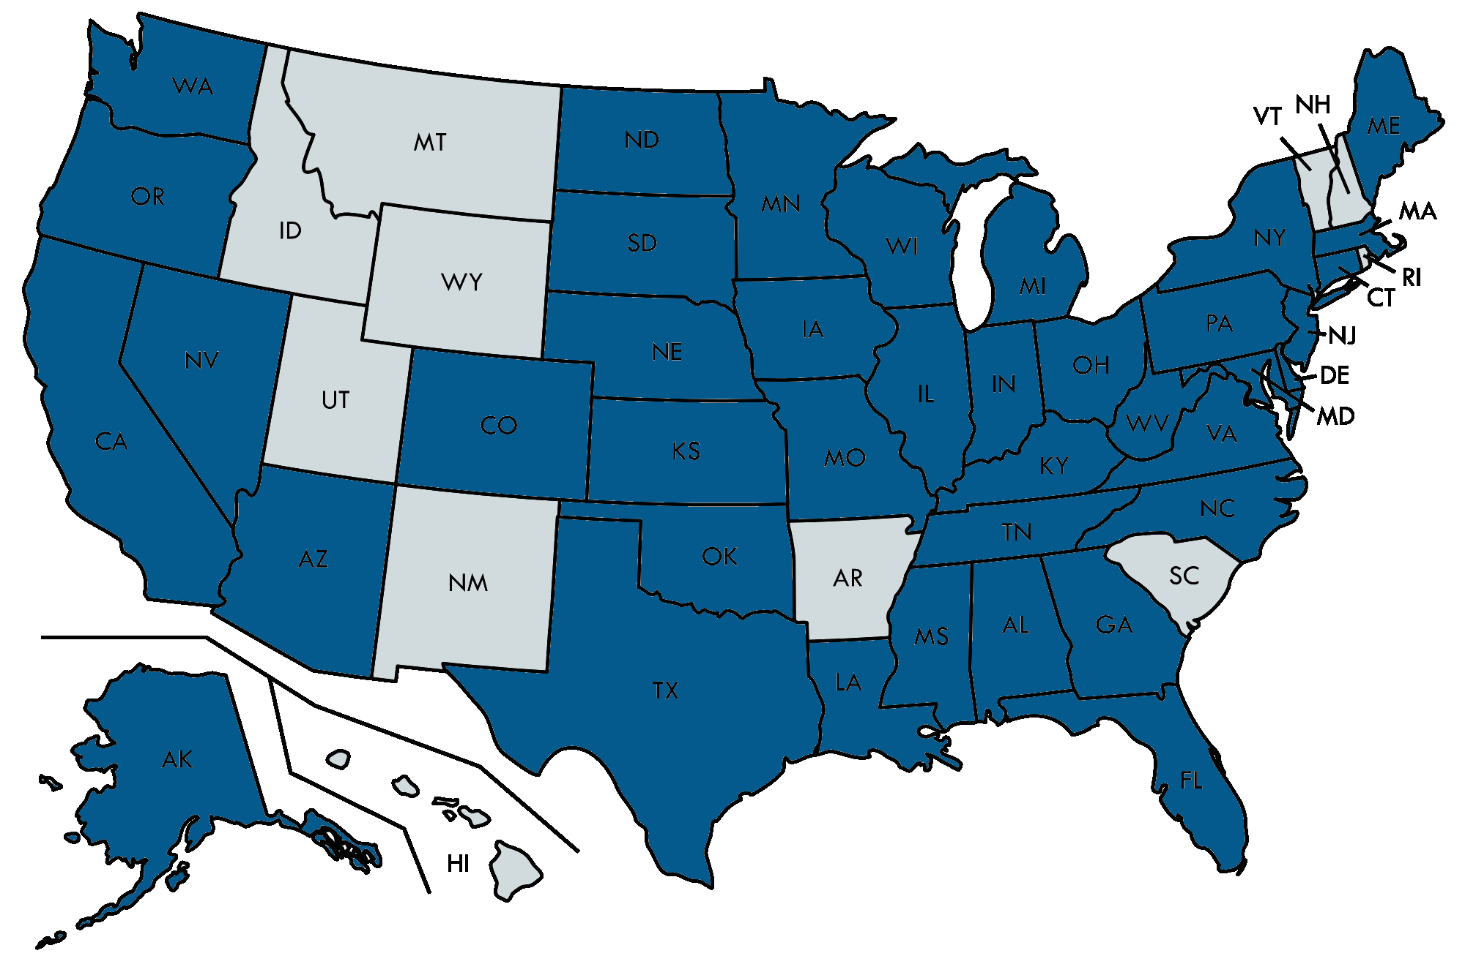
Board Member Organization Geographic Reach
Organizational Reach
States Served

Slide 8
Board Member Organization Services Offered

Slide 9
Board Member Organization Individuals Served

Slide 10
Board Member Organization Populations Served
Most Common Populations Served
Other Populations Served
Individuals with mental illness (3 respondents)
Aging populations (2 respondents)
Learning disabilities (1 respondent)
Individuals with chronic illness (1 respondent)
Veterans (1 respondent)

Slide 11
Board Member Organization Employees

